Slide 1
1 kg
1 /=
3 kg
4 /=
Max
7 kg
4 kg
5 /=
5 kg
7 /=

Slide 2
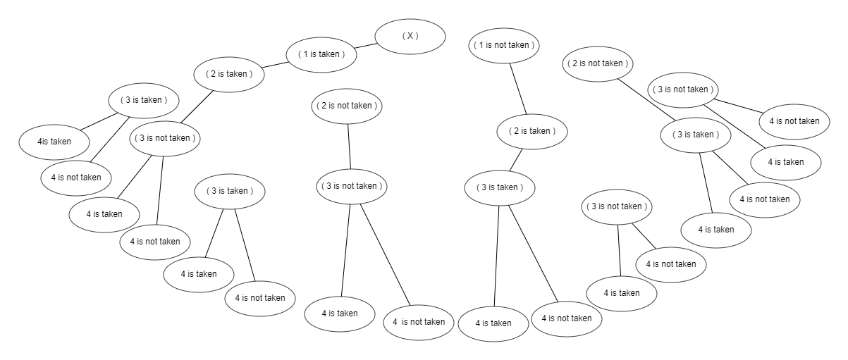

Slide 3
BAG SIZE
i - 1
i Weight= 2
i + 1
No. of taken elements

Slide 4
dp | 0 | 1 | 2 | 3 | 4 | 5 | 6 | 7
0
1
2
3
4
w | c
1 | 1
3 | 4
4 | 5
5 | 7
0 | 0 | 0 | 0 | 0 | 0 | 0 | 0
0
0
0
0
1
1
1
1
1
1
1
1
1
4
5
5
5
5
1
1
4
5
6
6
9
1
1
4
5
7
8
9
dp[i][j] = max( dp[i-1][j-w[i]]+c[i], dp[i-1][j] )

